Slide 1
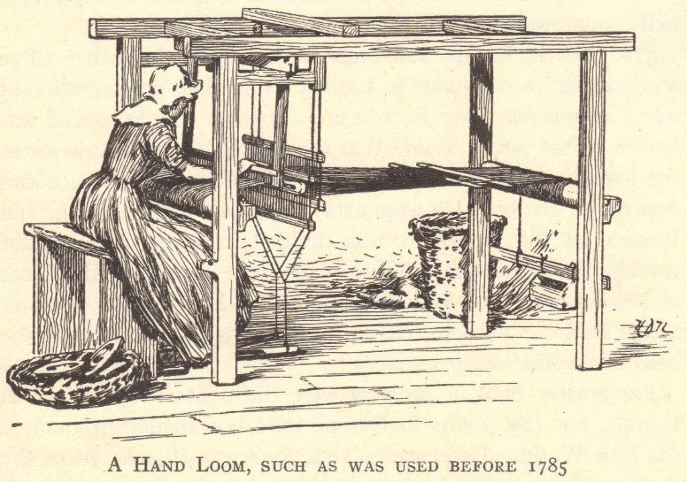
The Industrial Revolution
© Student Handouts, Inc.

Slide 2
What was the Industrial Revolution?
The Industrial Revolution was a fundamental change in the way goods were produced, from human labor to machines
The more efficient means of production and subsequent higher levels of production triggered far-reaching changes to industrialized societies

Slide 3
The Industrial Revolution
Machines were invented which replaced human labor
New energy sources were developed to power the new machinery – water, steam, electricity, oil (gas, kerosene)
Some historians place advances in atomic, solar, and wind energy at the later stages of the Industrial Revolution
Increased use of metals and minerals
Aluminum, coal, copper, iron, etc.

Slide 4
The Industrial Revolution
Transportation improved
Ships
Wooden ships → Iron ships → Steel ships
Wind-powered sails → Steam-powered boilers
Trains
Automobiles
Communication improved
Telegraph
Telephone
Radio

Slide 5
Developments
Mass production of goods
Increased numbers of goods
Increased diversity of goods produced
Development of factory system of production
Rural-to-urban migration
People left farms to work in cities
Development of capitalism
Financial capital for continued industrial growth
Development and growth of new socio-economic classes
Working class, bourgeoisie, and wealthy industrial class
Commitment to research and development
Investments in new technologies
Industrial and governmental interest in promoting invention, the sciences, and overall industrial growth

Slide 6
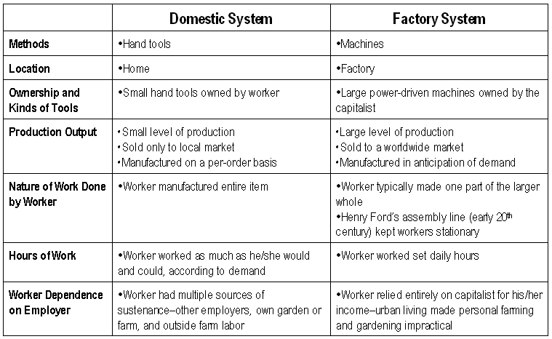

Slide 7
Why the Industrial Revolution Started in England
Capital for investing in the means of production
Colonies and Markets for manufactured goods
Raw materials for production
Workers
Merchant marine
Geography

Slide 8
Development of Steam Engines
Early water power involved mills built over fast-moving streams and rivers
Early water power had problems
Not enough rivers to provide the power needed to meet growing demand
Rivers and streams might be far removed from raw materials, workers, and markets
Rivers are prone to flooding and drying

Slide 9
Steam Engines
By 1800, steam engines were replacing water wheels as sources of power for factories
Factories relocated near raw materials, workers, and ports
Cities grew around the factories built near central England’s coal and iron mines
Manchester, Liverpool

Slide 10
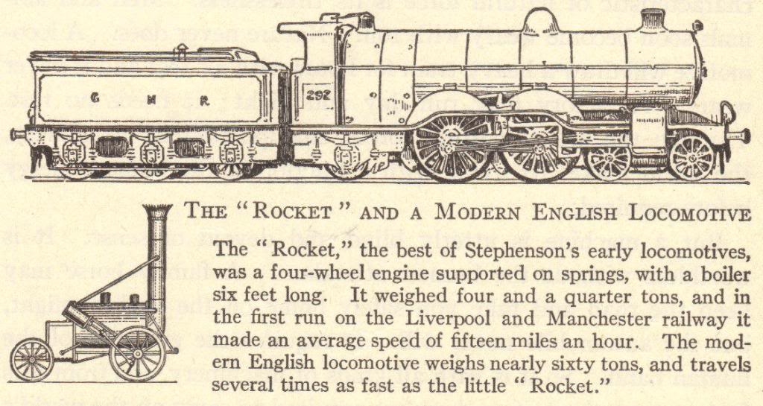
Transportation
Increased production
Search for more markets and raw materials
Better and faster means of transportation
Before the Industrial Revolution
Canal barges pulled by mules
Ships powered by sails
Horse-drawn wagons, carts, and carriages
After the Industrial Revolution
Trains
Steamships
Trolleys
Automobiles

Slide 11
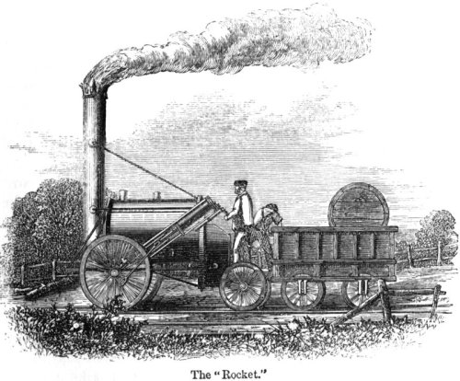

Slide 12
Agriculture and Industry
The Industrial Revolution brought machinery to farms
The use of farm machinery meant that fewer farm workers were needed
Displaced farm workers moved to the cities to find work in factories
This is called rural-to-urban migration
Growing populations in urban cities required farmers to grow more crops
Food to eat
Raw materials (like cotton) for textile factories

Slide 13
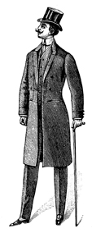
The Results of the Industrial Revolution

Slide 14
Results of the Industrial Revolution
Economic Changes
Expansion of world trade
Factory system
Political Changes
Decline of landed aristocracy
Social Changes
Development and growth of cities
Science and research stimulated
Industrial capitalism
Unemployment
Growth and expansion of democracy
Rise to power of businesspeople
Increased government involvement in society
Nationalism and imperialism stimulated
Increased power of industrialized nations
Improved status and earning power of women
Increase in leisure time
Population increases
Problems – economic insecurity, increased deadliness of war, urban slums, etc.
Increased standard of living
Mass production of goods

Slide 15
Problems of the Factory System
Factories were crowded, dark, and dirty
Workers toiled from dawn to dusk
Young children worked with dangerous machinery
Employment of women and children put men out of work
Women and children were paid less for the same work
Technological unemployment – workers lost their jobs as their labor was replaced by machines
Notes:
Note: Silas Marner by George Eliot describes the changing textile industry due to technological advances.

Slide 16
Poor Living Conditions
Factories driven solely by profit
Businesses largely immune to problems of workers
Factory (also company or mill) towns
Towns built by employers around factories to house workers
Workers charged higher prices than normal for rent, groceries, etc.
Workers often became indebted to their employers
Created a type of forced servitude as workers had to stay on at their jobs to pay their debts
Considered paternalistic by workers
Some employers had workers’ interests at heart
But workers wanted to control their own lives
Notes:
Note: Pullman in Chicago, Illinois, is an excellent example of a well-intentioned factory town being disliked by workers.

Slide 17
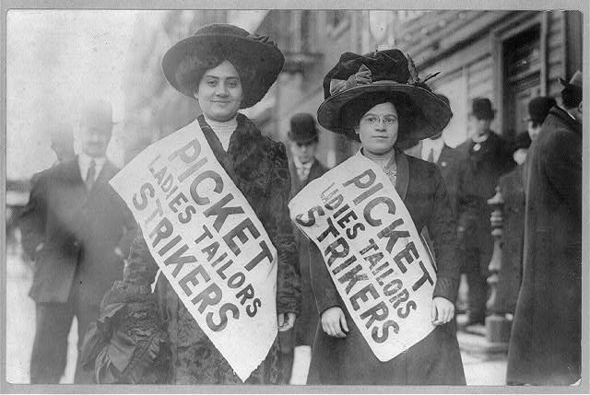
The Labor Movement

Slide 18
Changing Employee-Employer Relationships
Domestic system
Workers and employers knew each other personally
Workers could aspire to become employers
Factory system
Workers no longer owned the means of production (machinery)
Employers no longer knew workers personally
Factories often run by managers paid by the corporation
Relationships between employers and employees grew strained

Slide 19
Slum Living Conditions
Factory towns – often built and owned by factories
Not a strange concept to rural-to-urban migrants who were used to living on a lord’s estate or property
Full of crowded tenements
Few amenities
Tenements – buildings with rented multiple dwellings
Apartment buildings with a more negative connotation
Overcrowded and unsanitary
Workers were unsatisfied both inside and outside the factories

Slide 20
Rise of Labor Unions
Before labor unions, workers bargained individually – “individual bargaining”
Before factories, a worker could bargain for better wages and working conditions by arguing his or her particular skills
But in factories, work is routine and one worker can easily replace another
With labor unions, workers bargained together as a group, or collective – “collective bargaining”
Organized groups of workers elected leaders to bargain on their behalf
Used tools (such as strikes) to gain rights

Slide 21
Weapons Used by Unions and Employers
Weapons Used by Employers
At-will employment
Company unions
Weapons Used by Unions
Boycotts
Check-offs
Individual bargaining
Injunctions
Laws that limit union activities
Lockouts
Open shops
Right-to-work laws
Welfare capitalism
Yellow-dog contracts
Closed shops
Collective bargaining
Direct political action
Favorable labor legislation
Feather-bedding
Lobbying
Picketing
Sabotage
Strikes
Union label
Union shops
Relocation
Blacklists
Threat of foreign competition
Outsourcing
Notes:
Note: Under employers’ weapons, “relocation,” “outsourcing,” and “threat of foreign competition” are relatively new, coming into play in the last quarter of the twentieth century. These weapons make for a lively classroom discussion. For example, students might examine reasons why automobile manufacturing plants have relocated to nonunionized southern states, the number of automobiles imported into the United States each year, and the number of parts (engines, transmissions, etc.) which are no longer made at an individual automobile plant but are instead made by smaller, nonunionized suppliers.

Slide 22
Legal Protections for Workers
Limited hours for women
Later – equal pay for equal work
Eventual end to child labor
Schools and requirements for school attendance grew as children were removed from the workforce
Health and safety codes
Minimum wage
Legalization of unions

